Slide 1


Pedibus Development
Sponsored by Capital City Pedicab Company
In affiliation with the FSU and FAMU College of Engineering
Team 18
Andrew Galan
John Hassler
James McCord
Onyewuchi Ebere
Sponsor Instructors
Ron Goldstein Dr. Kamal Amin
Faculty Advisor Dr. Chiang Shih
Dr. Patrick Hollis

Slide 2

Background
The pedibus is a pedal-powered vehicle used for transportation that seats a variety number of passengers depending on size.
The idea was developed to provide as an eco-friendly traveling entertainment center to attract people of all ages and professions.
        Some models contain alcohol distribution consoles in the center.
Also referred to as the pedal crawler, pubcrawler, and party bike.
The pedibus has grown in popularity over the last five years.

Slide 3
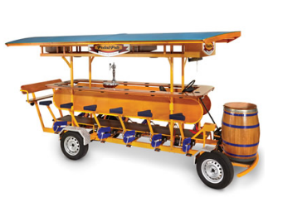
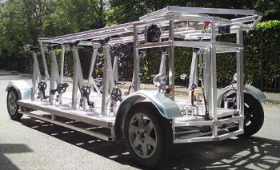
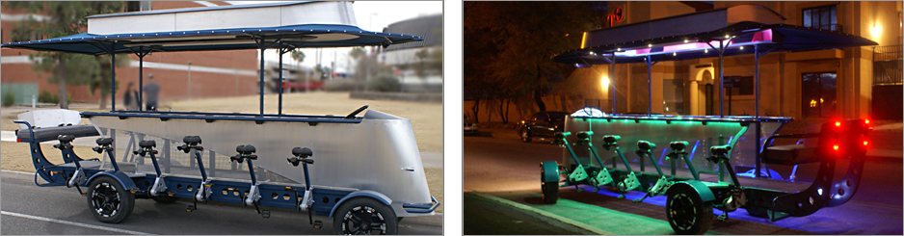
Existing Models
James McCord

Slide 4
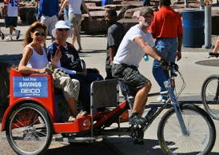
Sponsor
Ron Goldstein
Tallahassee Native
Owner of Capitol City Pedicabs
Wants to manufacture the Pedibus for sale
James McCord

Slide 5
Design Concepts
The Pedibus is broken down into three main components
        Structural frame update
        Power transmission update
        Steering and braking update
James McCord

Slide 6
Structural Frame
Requirements:
  Must be strong enough to support passengers weight
  Must be as light weight as possible
  Must be low cost
  Must be reliable with low maintenance
James McCord

Slide 7
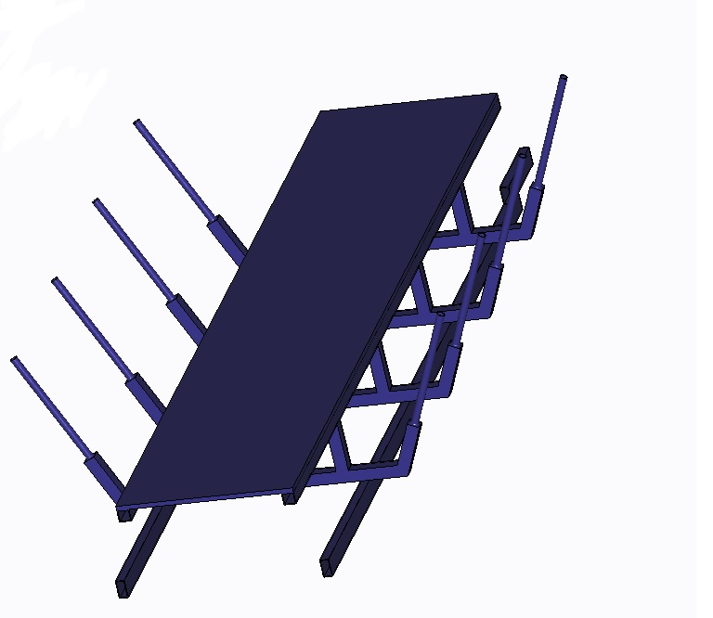
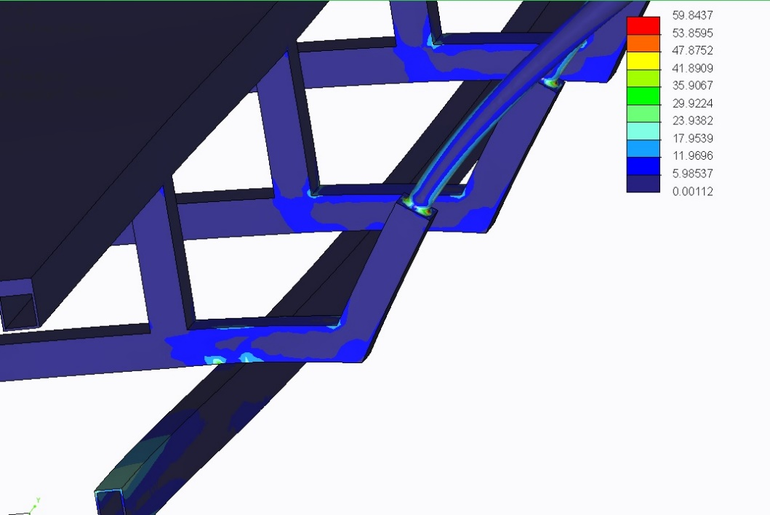
Aluminum or steel
Initially we wanted to make a frame completely of Aluminum but after further analysis and modeling we concluded a mixture of the two would result in the most strength to weight ratio.
Using a minimalistic lower base of two steel rectangular beams to support the majority of the weight and an aluminum substructure above that.
James McCord

Slide 8
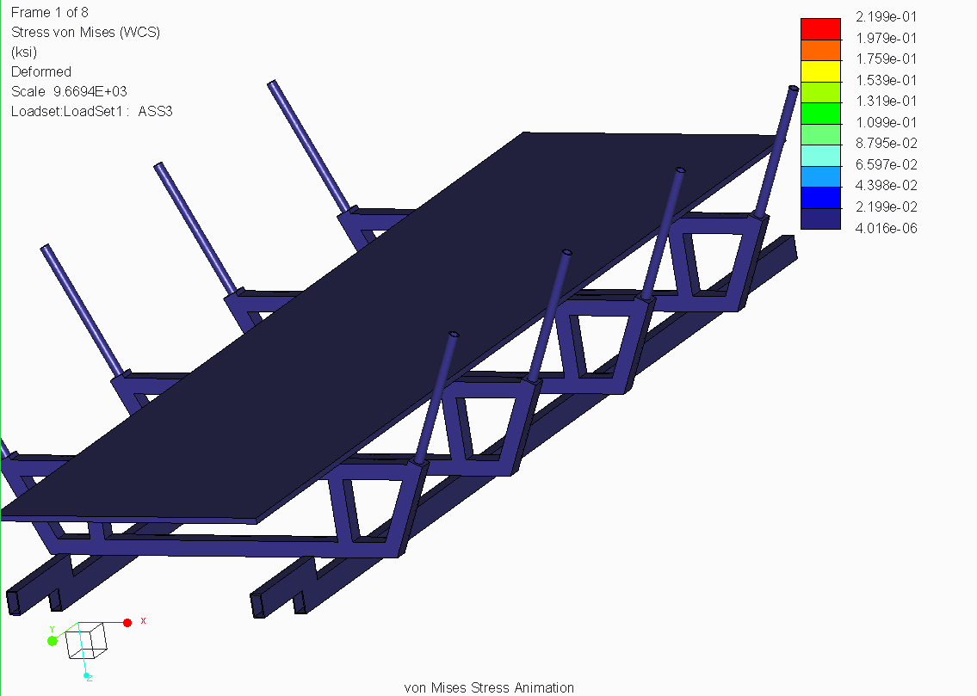
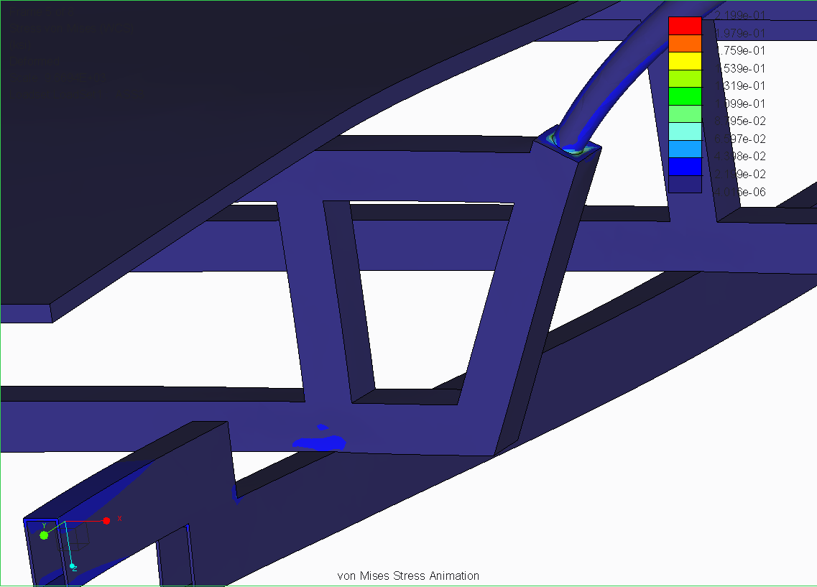
Improved Design
James McCord

Slide 9
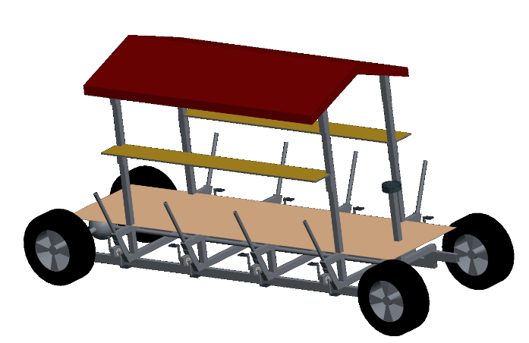
New scope of use
Based on latest conversation the bus also need to be able to support children and sell ice cream
Our top will have adjustable heights for seats and table top
James McCord

Slide 10
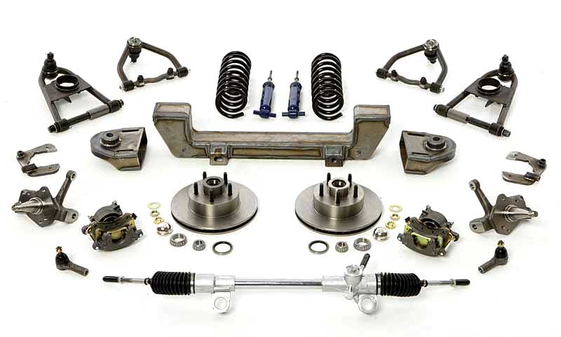
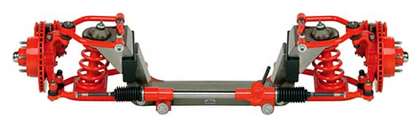
Front Axle and Suspension
Model: Mustang II IFS Front Beam Axle
Pros:
All components are included and assembled
Aesthetically clean finish
Extremely durable and reliable
Includes suspension
Cons:
More expensive than simpler design
Heavier than simpler design without suspension
Andrew Galan

Slide 11
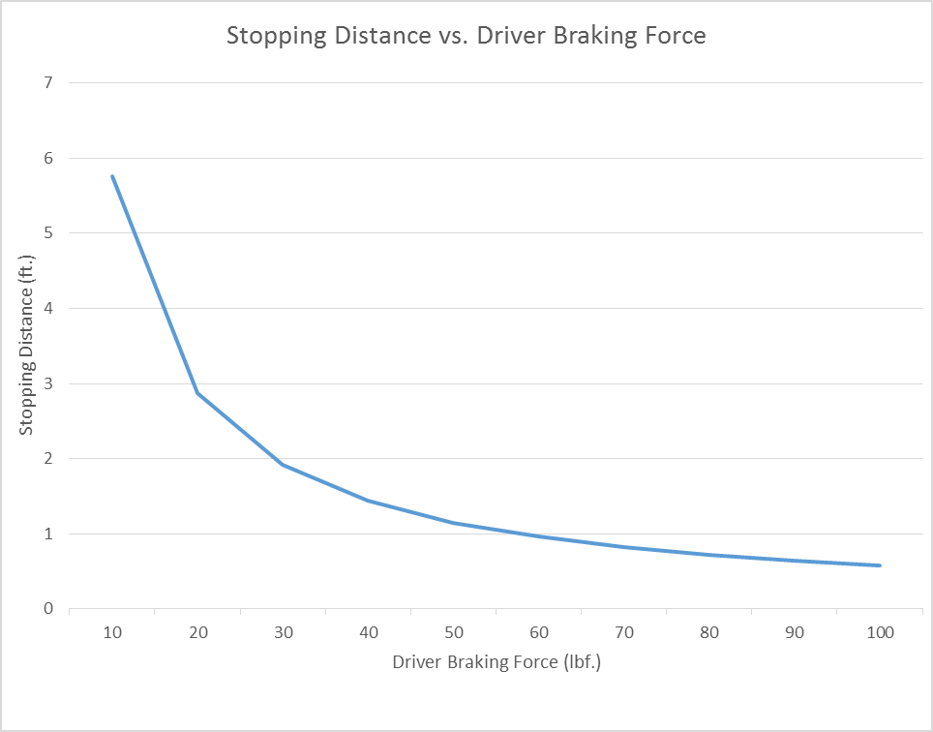
Braking Analysis – Hydraulic Disc Brakes
Assumptions
3000 lb. vehicle sprung weight (including passengers).
Maximum velocity of 5 mph.
Forces applied by driver ranged from 0-100 lbf.
Evaluation
Considerations included:
Force produced by brake pedal
Pressure from the master cylinder
Force provided by the caliper
Force due to the clamps
Friction force caused by the brake pads
Torque applied to the rotor
The force measured about all four tires
Andrew Galan

Slide 12
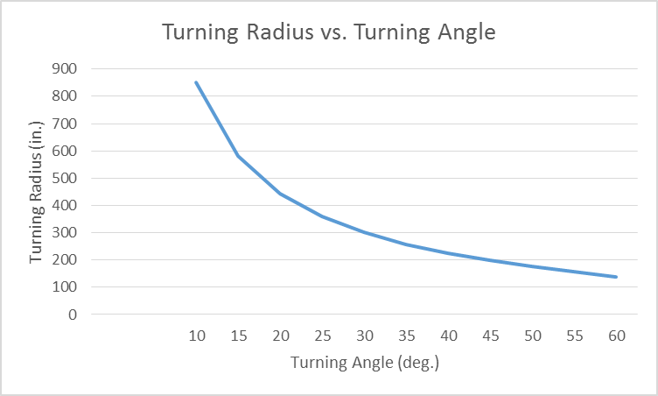
Steering Analysis
Assumptions
There is a 50/50 weight distribution, front to rear.
Wheel base of 140 inches in length
The Pedibus will interact with cornering
Maximum of 60 degrees turning angle
Evaluation
The greater the turning radius, the smaller the turning angle.
Andrew Galan

Slide 13
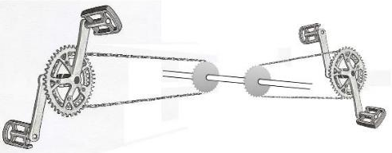
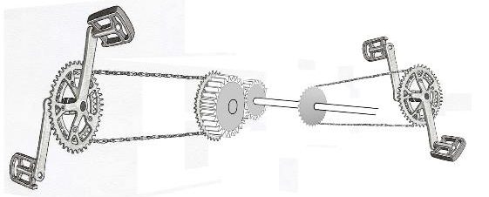
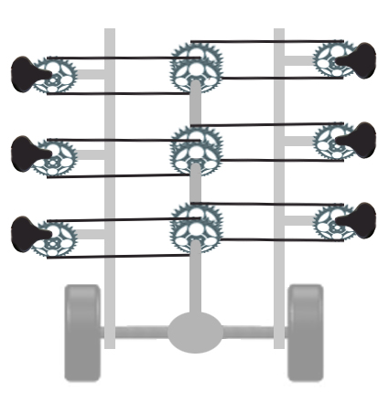
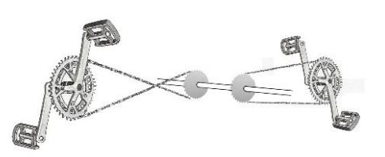
Drive train update
In our previous presentation we discussed the linkage between the pedals and the drive shaft
We chose option three for its simplicity
John Hassler

Slide 14
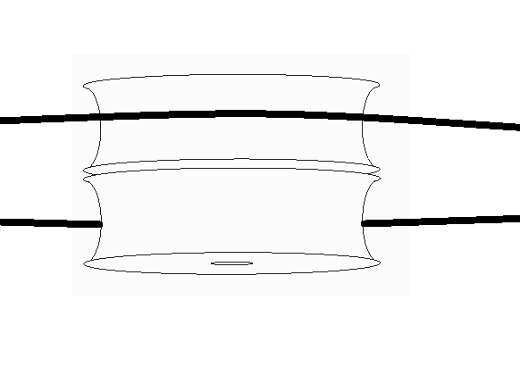
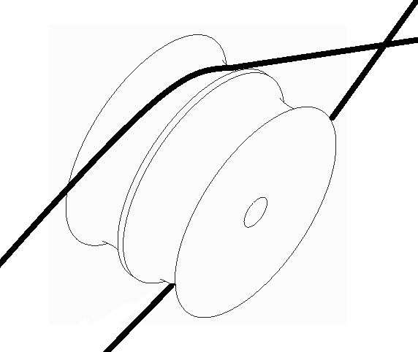
Pulleys to offset chain
Pros
will keep the pulleys offset and reduce deflection of the chain
Cons
if the chain binds it will saw through the pulley like a chainsaw blade
John Hassler

Slide 15
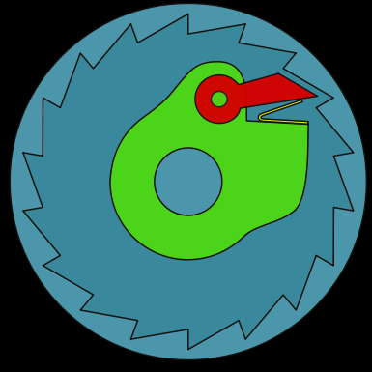
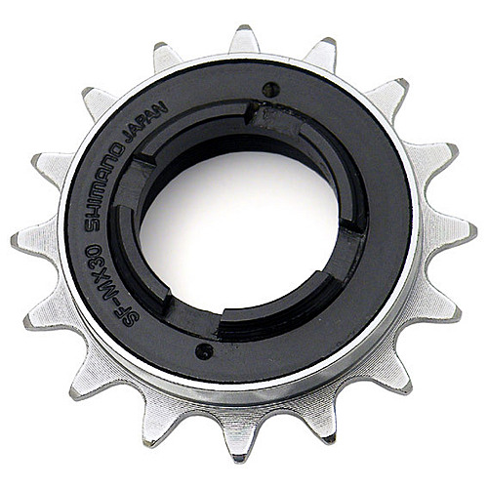
freewheel
John Hassler

Slide 16
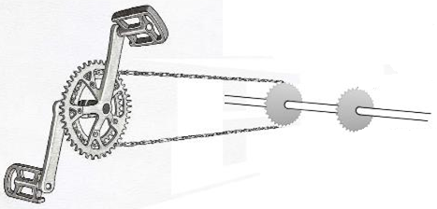
Drive train update
Where to place the free wheel?
Free wheel at pedals
  Both gears and the chain turn whenever the vehicle is moving
  Better design for maintenance
  Not as safe
Free wheel at drive shaft
  Only the drive shaft turns whenever the vehicle is moving
  Better design for safety
  More involved maintenance
John Hassler

Slide 17
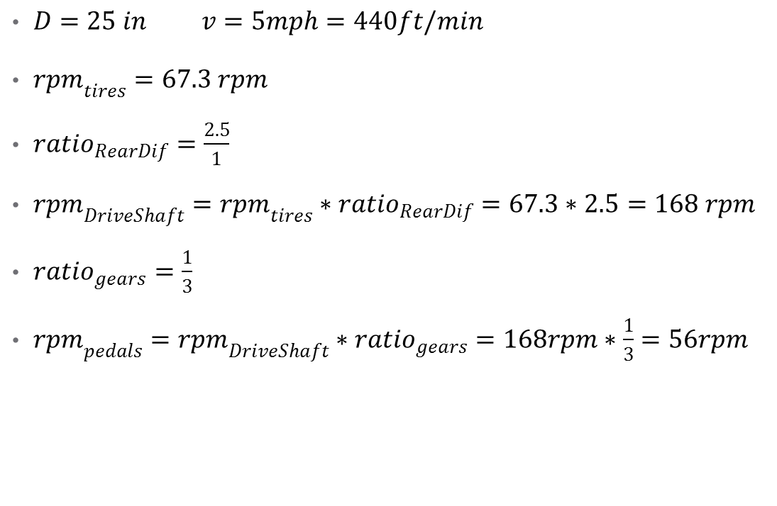
Gear Ratio Selection
$D=25 in v=5mph=440ft/min$
${rpm}_{tires}=67.3 rpm­$
${ratio}_{RearDif}=\frac{2.5}{1}$
${rpm}_{DriveShaft}={rpm}_{tires}∗{ratio}_{RearDif}=67.3∗2.5=168 rpm$
${ratio}_{gears}=\frac{1}{3}$
${rpm}_{pedals}={rpm}_{DriveShaft}∗{ratio}_{gears}=168rpm∗\frac{1}{3}=56rpm$

Slide 18
Potential challenge
Speed: It will be difficult to maintain a speed of 5mph due to the total weight of the pedibus.
Peddling torque: the torque input has been kept at minimum by reducing the total weight of the pedibus.
Efficiency: parts that will threaten the efficiency of the pedibus that have always surfaced in the design. Since these parts can not be done away with, we have introduced lighter parts to balance their effects
Onyewuchi Ebere

Slide 19

Brief analysis showing the importance of total vehicle weight on the peddling torque
Drag Force on Pedibus
$F_{d}=\frac{1}{2}ρAC_{d}v^{2}$
$c_{d}=1.05$ (Drag coefficient for flat surface perpendicular to drag force)
$v=5mph$
$A=25{ft}^{2}$
$ρ=1.226\frac{kg}{m^{3}}$
$F_{d}=8N$
Onyewuchi Ebere

Slide 20

Brief analysis showing the importance of total vehicle weight on the peddling torque
Rolling Resistance on Pedibus
$F_{rr}=C_{rr}∗Weight$
$C_{rr}=.015$ average Rolling resistance for car tire on asphalt
$Weight=1361 kg∗9.81\frac{m}{s^{2}}$
$F_{rr}=200N$
Rolling Resistance is 25 times as high as wind resistance
Dominant factors on rolling resistance are the tire selection and total weight of vehicle
Onyewuchi Ebere

Slide 21
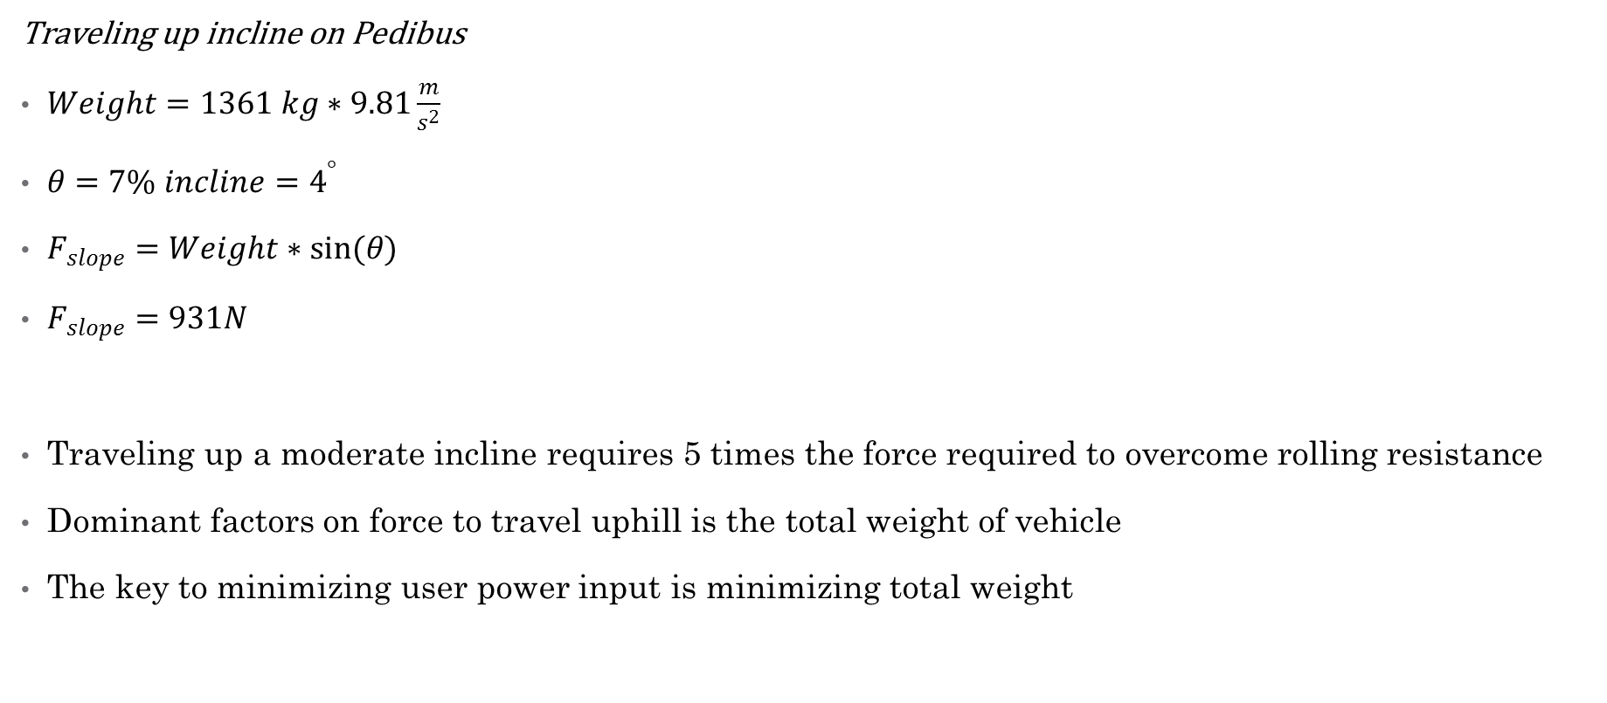
Brief analysis showing the importance of total vehicle weight on the peddling torque
Traveling up incline on Pedibus
$Weight=1361 kg∗9.81\frac{m}{s^{2}}$
$θ=7\% incline=4^{°}$
$F_{slope}=Weight∗sin(θ)$
$F_{slope}=931N$
Traveling up a moderate incline requires 5 times the force required to overcome rolling resistance
Dominant factors on force to travel uphill is the total weight of vehicle
The key to minimizing user power input is minimizing total weight
Onyewuchi Ebere

Slide 22
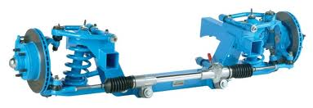
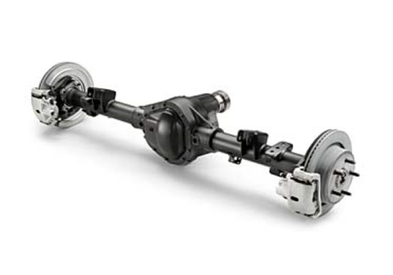
Here are some of the parts the gave rise to the excess weight.
Front suspension and steering assembly
Rear axle and rear differential
Onyewuchi Ebere

Slide 23
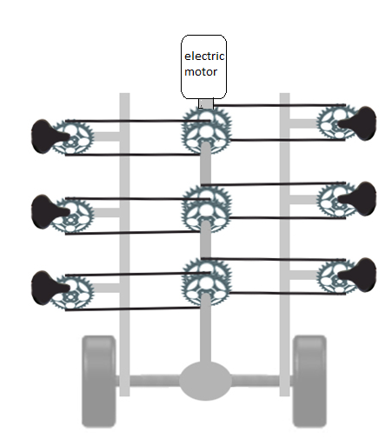
Power Improvements
The majority of the resistance force that must be overcome by the passengers is directly related to the total weight of the vehicle
For traveling up inclines or operating at less than full capacity the vehicle should have a power assist electric motor

Slide 24
Budget
Onyewuchi Ebere

Slide 25
Future plans
Order raw material and parts for construction of Pedibus
Design and implement a power assist drive system
Perform more dynamic analysis
Finalize overall structural design
Find outside resources to help with assembly
Run performance test on assembled vehicle
Keep in close contact with sponsor, advisors, and bicycle mechanic
Onyewuchi Ebere

